Slide 1
The Games Development Process
David Braben

Slide 2
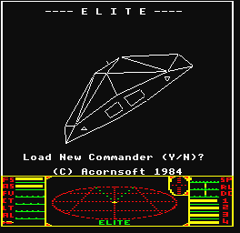

A Bit About Me…
I’m an ‘old timer’
  I’ve been writing games commercially for
  over 20 years, starting with “Elite”, written
  with Ian Bell in the early 80s.
I’m the Chairman of Frontier Developments Ltd
  We are 45 people, based in Cambridge, England
  We have four games in development, one in design

Slide 3
Games Development
Games take an long time to develop (often 2+ yrs)
  To meet people’s expectations of the amount of content
  Supporting different ‘platforms’ and foreign languages
The ‘standard’ is changing rapidly
  They need to be at least as good as the competition
  The competition are the games released in the future
  No good looking at what is out now – they will be out of date
Hence you need to know the future!

Slide 4
Where is the Games Industry Now?
Parallel Progression – Films vs Games
Films sold by technology pre 1920
  Still common until 1960
  Talkies/Movies, Technicolor, Cinemascope, 3D glasses
Games pre 2000 sold primarily by technology
In comparison, we’re in the early 1920s!

Slide 5
So What Does the Future Hold?
Prediction always a dangerous business
  Hover-cars, anyone?
  Trends give some help in this
Moore’s Law set to continue or be exceeded
  Intel claim next ten years performance increase assured
  Sony claim PS3 to be 1000 times PS2 performance
Is there any reason to believe trends will change?

Slide 6
Will People Continue to Upgrade?
Previous reasons to upgrade a $1000 PC
  1. Games needing greater performance
  2. Unreliability of the old one
  3. Getting web & email support on the new machine
Previous reasons to upgrade a $200 console
  1. Games are significantly ‘better’
  2. Fancy new features (eg DVD, net connection)
Will the next console upgrade be as significant?
  Benefit from Megadrive->PS1 v. clear
  Benefit PS1->PS2 smaller
  Benefit PS2->PS3 ?

Slide 7
Breaking New Ground
“At least” as good as the competition…
Really? Surely “far better” is more like it!
  Everyone claims this is the case with their game
To achieve this, let’s look at the obstacles…

Slide 8
Restrictions Effecting Game Design
Some Examples:
  No satisfactory two-way conversations
    Limited to recorded speech and menu driven replies
  Lack of emotion
    Little subtlety in facial expressions and body language
    Player unable to convey any subtlety themselves
  Fiddly control devices
    Off-putting to non-technical or older audience
Leads to current ‘genre’ games
  Reinforced by risk-averse publishers

Slide 9
Why Change?
It’s easy to appeal to existing audiences
  Publishers encourage re-hash games, as sales stats are known
  Developers have ready-made ideas to copy
  Tried and tested distribution and marketing in place
But games with fresh appeal are often more successful
  The Sims, Barbie Fashion Designer, Deer Hunter, Myst.
  And we’re looking to be “far better” than the competition…
Where are those elusive new games?

Slide 10
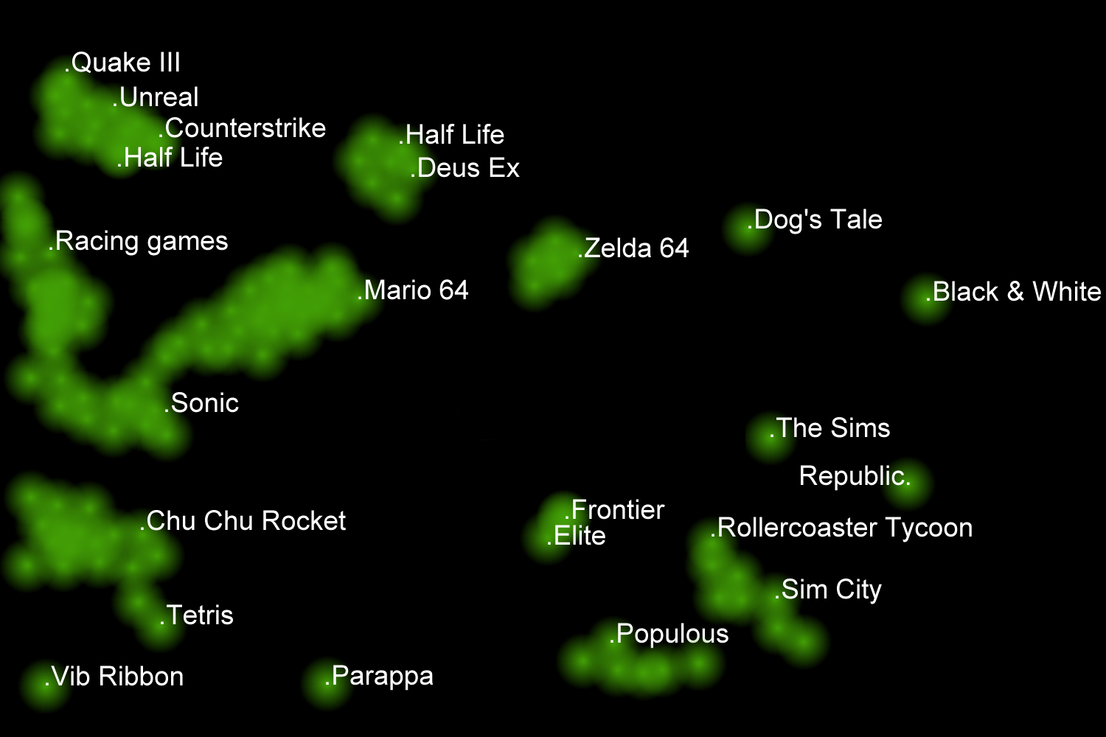

Slide 11
Opening Up These Frontiers
Are we looking far enough ahead?
  Ready acceptance of current solutions -‘how did they do it?’
  Minor incremental improvements (in eg poly count)
  Made worse by a hand-to-mouth development cycle
  Too many similar games cause audience apathy
  Games Designers separated from the technology
When is a technological change appropriate?
  Easy to embrace new technology without benefit
    Games design to show-case new technology
  Games moved to 3D when 2D was frequently more suitable

Slide 12
What Technologies do we need?
Graphics/Rendering
  All games use the same hardware (lock-in)
  Scope for variation still present
Animation
  Real-time ‘Inverse Kinematic’ animations
Controls/Camera
  Fiddly control systems are off-putting to many people
  Camera work in a game is more difficult than in a film
Communication
  Speech, story telling. Often the ‘poor relation’

Slide 13
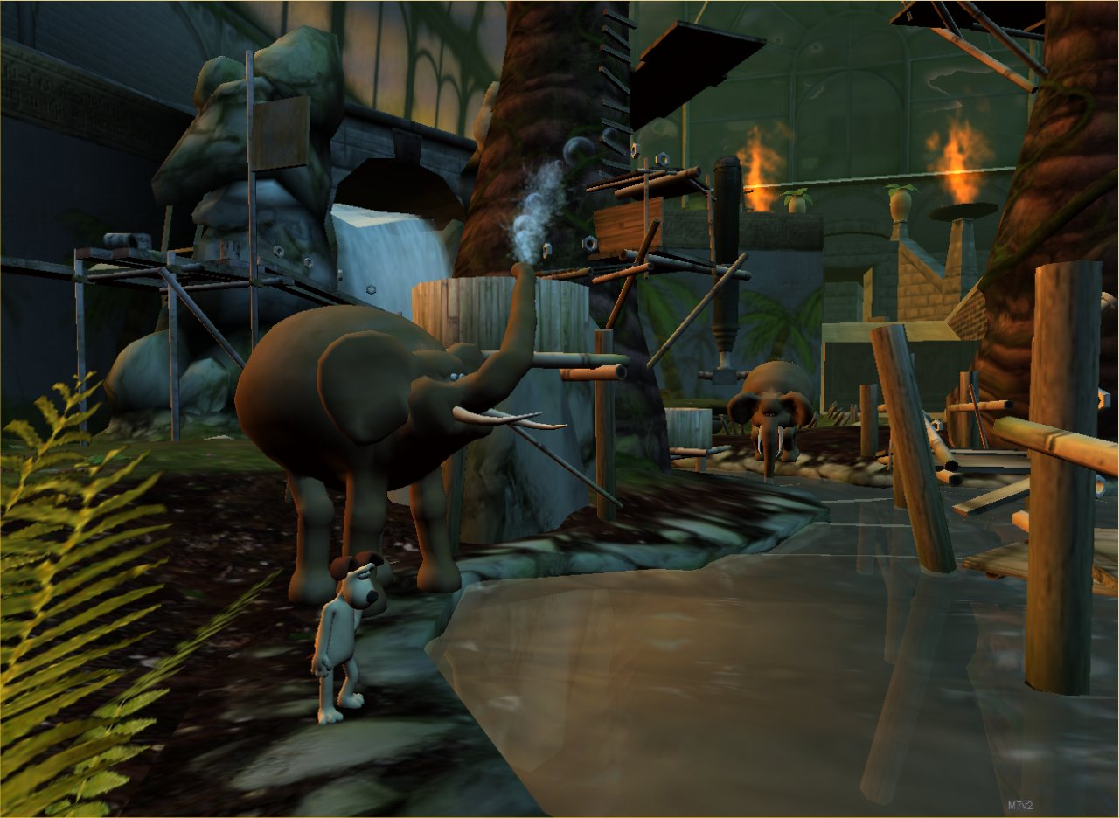
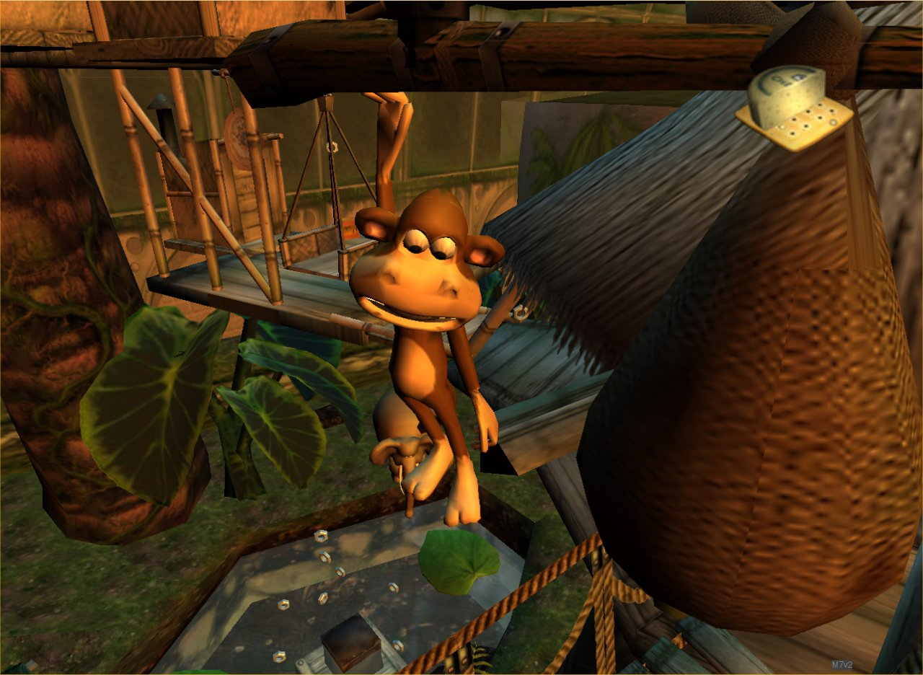
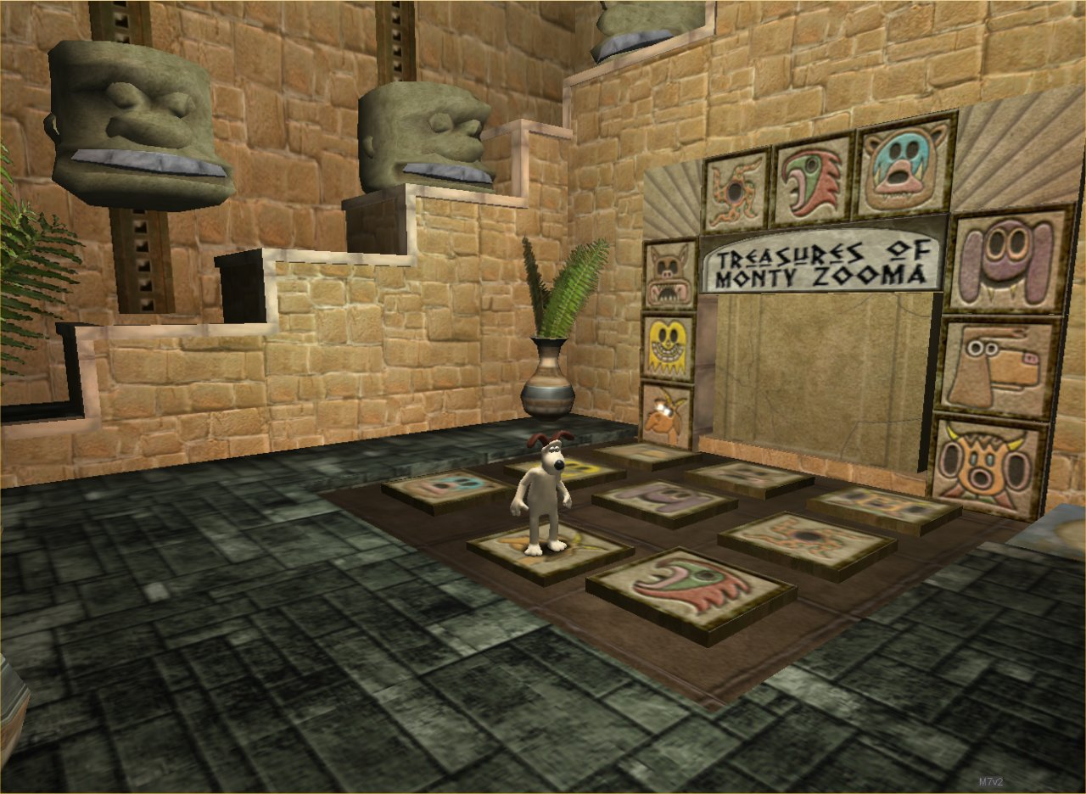
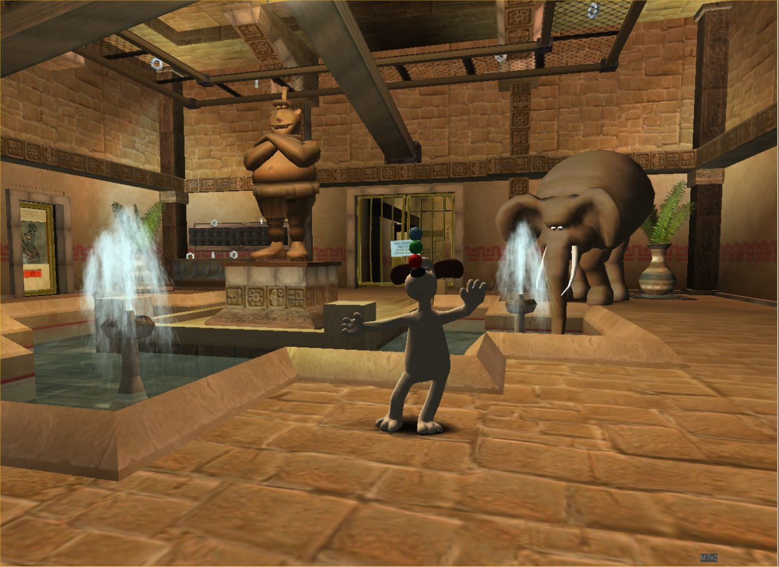
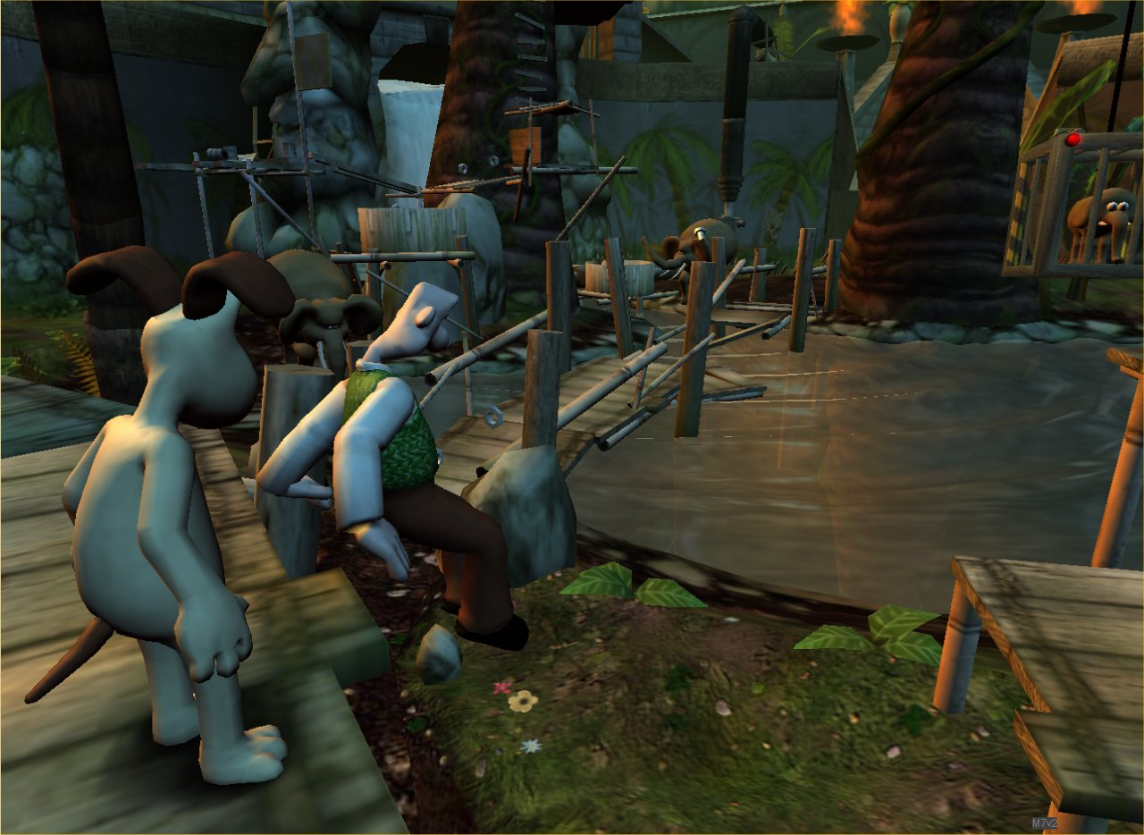
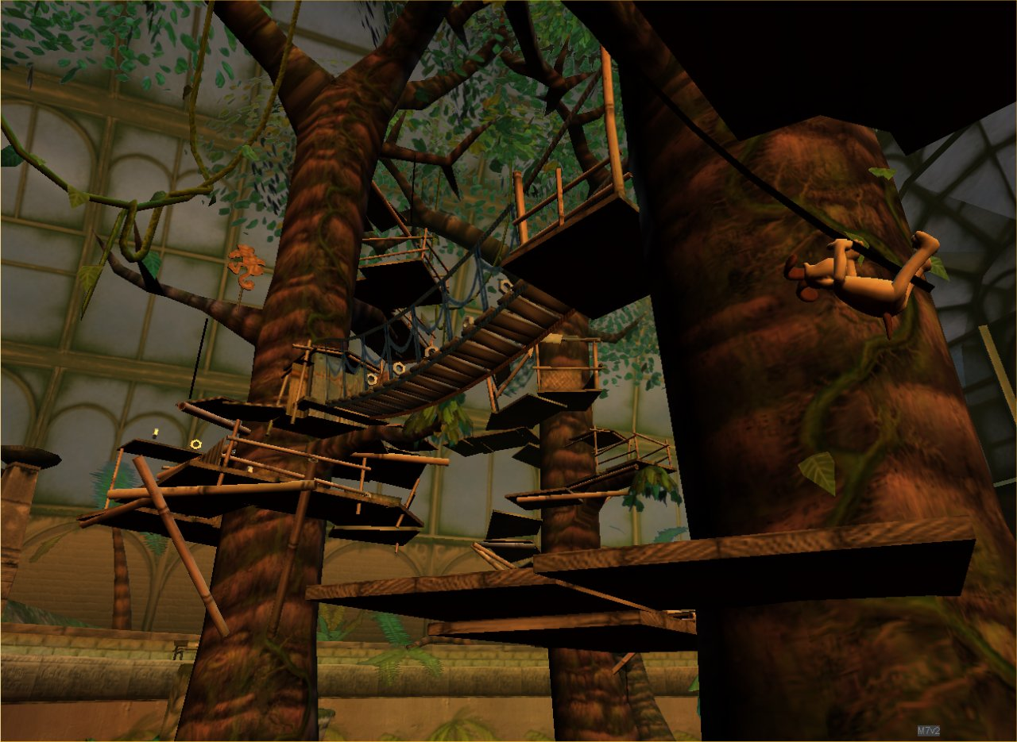
An Example: “Wallace & Gromit”

Slide 14
A Quick Look at the Technologies…
Graphics
  Automatic Level of Detail reduction (“LODding”)
  Depth of Field
Animation
  Real time animation blending
  “Inverse Kinematics”
Camera
  Camera directions embedded in the scene
Lighting
  Directional, Point, Spots
  Surface effects – specular lighting, environment mapping

Slide 15
…And the people that put it together
“Tools Team”
  Provide the underlying technologies and editors
  Run as a separate team
  Support multiple games and multiple game ‘platforms’
  Some developers buy in as “Middleware”
“Game Team”
  Made up of Programmers, Level Designers, Artists, Animators, Musicians, Script Writers, Actors, Managers
  Put together all the game-specific content

Slide 16
Summary
Games Development is a fast moving field
You will be expected to ‘learn on the job’
The expected programming standards are at least as high as any other field
Thank you for listening.
Questions & Answers

